Slide 1

OPTIMISING THE EFFECTIVENES OF THE RAILWAY ULTRASONIC TESTING MACHINE CAR. BY: REFILWE MAGANYANE

Slide 2
RESEARCH CONTENT
CONTEXT
RESEARCH OBJECTIVE
RESEARCH FRAMEWORK
CONCEPTUAL MODEL
CORE QUESTIONS AND SUB-QUESTIONS
DEFINITIONS AND DELINIATION
RESEARCH STRATEGY
RESEARCH MATERIAL
RESEARCH PLAN
1

Slide 3
RESEARCH CONTEXT
Transnet has shifted its capital expenditure focus over 7 years from maintenance expenditure to expansionary investments on rail and port projects across the country. This expansion is expected to result in a substantial increase in freight volumes.
There are however old railway lines that have defects that were declared small enough to not have any detrimental effects on the integrity of the railway itself. Rail defects are deemed the primary problematic cause of reduced rail reliability and increased probabilities of rail break and derailments occurrences.
It has been noted that the freight volume is expected to increase by an average of 21 Million tons per annum across all lines and research shows that an increase in the tonnages, inevitably results in an exponential growth; the larger the quantity the greater the increase in defect size.

Slide 4
……RESEARCH CONTEXT
The growth rate, severity and the number of defects need to be monitored substantially, to ensure that the reliability of the railway is maintained.
An automated railway ultrasonic testing machine car (UMC) was introduced to monitor and alert railway masters of the rail conditions.
There is however no reference or supporting theory that states how frequent the UMC should run in order to effectively detect defects, hence this research is aimed at yield recommendations that will eventually yield developing a reference standard that will act as a guidance.

Slide 5
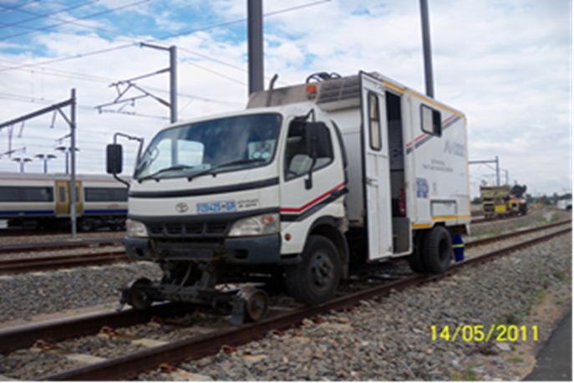
The Ultrasonic testing Machine Car

Slide 6
RESEARCH OBJECTIVE
The objective of the research is to develop a theory that will act to optimise the effectiveness of the Ultrasonic testing Machine Car with regard to the rate at which it should run by establishing a correlation between the Ultrasonic testing Machine Car running rate and the number of rail defects present.

Slide 7
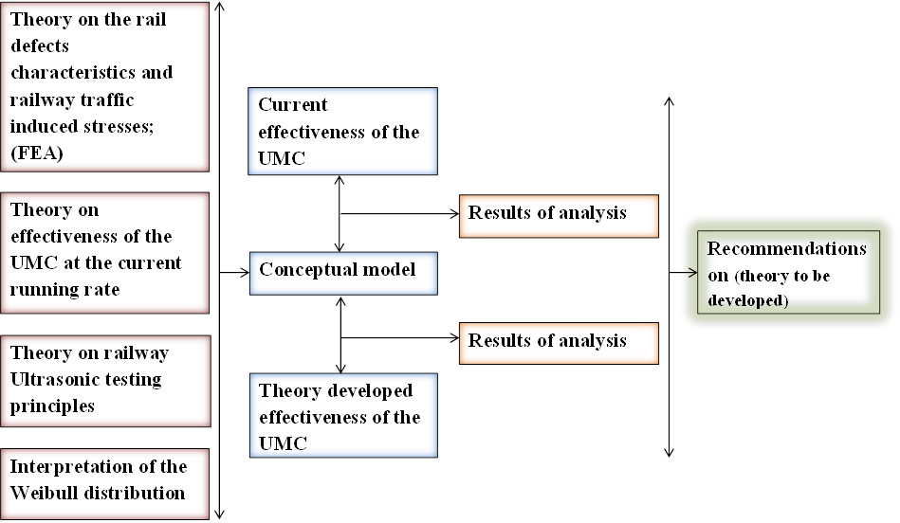
RESEARCH FRAMEWORK

Slide 8
RESEARCH FRAMEWORK
By studying the theory on the rail defects characteristics and railway traffic induced stresses, the effectiveness of the UMC at the current running rate, the ultrasonic testing principles and conducting interpretation of the Weibull distribution a conceptual; a conceptual model will be derived to evaluate and compare the current effectiveness of the UMC to the theory developed effectiveness of the UMC on the Transnet railway lines.
The conceptual model will yield results that will give recommendations of developing a theory that will denote how frequent the UMC should run in correlation to the severity and number of railway defects.

Slide 9
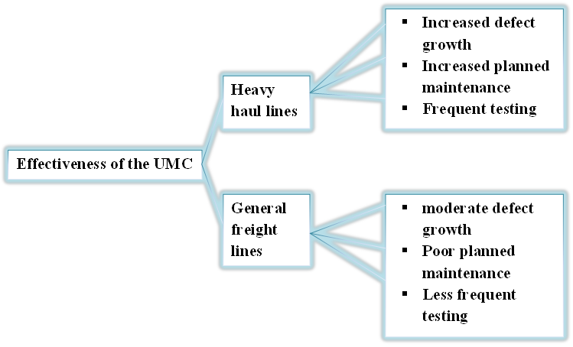
CONCEPTUAL MODEL
Core concept Dimensions Aspects

Slide 10
RESEARCH CORE QUESTION AND SUB-QUESTIONS
Core questions
1) First central question: What conceptual model is effective for assessing the effectiveness of the current UMC and the theory developed UMC?
What is the current effect of the UMC car on monitoring defects and assuring that they do not cause derailments?
What affects the rate at which defect within the rails grows?
What criteria is relevant for assessing the effectiveness of the UMC?
2) Second central question: What do we learn by comparing the results from the analyses of the 2 objects in order to make recommendations on how to develop an effective theory and model that will act to optimise the effectiveness of the UMC?
By establishing a correlation between the rate at which the UMC should run and the railway defects characteristics, can a model be developed?

Slide 11
DEFINITIONS AND DELINIATION
Ultrasonic testing: The testing of a rail material for internal defects using sound wave vibration energy. The sound energy is created in the probe, transmitted into the rail and an indication of the rail thickness or / and internal flaws is received, without impairing the rail's future usefulness.
UMC: Ultrasonic testing machine car that tests both railway legs simultaneously using wheel probes that utilises the immersion testing technique, the car travels at < 30km/hr for efficiency purposes.
Finite element analysis: Use of mesh generating techniques to divide a complex problem into small elements and using the FEM software to measure analyse effects of stresses on the small elements.
This research is only aimed at developing a theory that will govern the rate at which the UMC should run and is not aimed at combating railway defects or improving ultrasonic testing principles.

Slide 12
RESEARCH STRATEGY
Literature studies.
Interviews with UMC contractors and different depots maintaining a variety of railway dimensions.
Running laboratory and field tests.
Content analysis of specifications, Standard operating procedure and contracts.

Slide 13
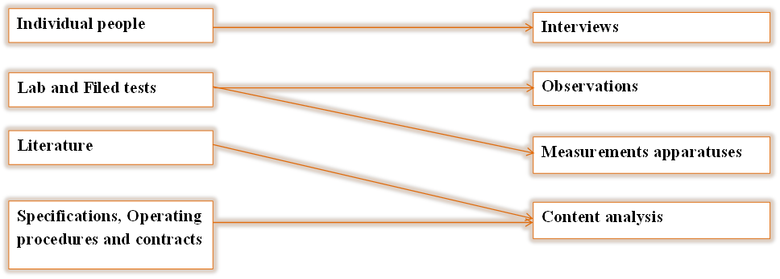
RESEARCH MATERIAL
Sources Accessing

Slide 14
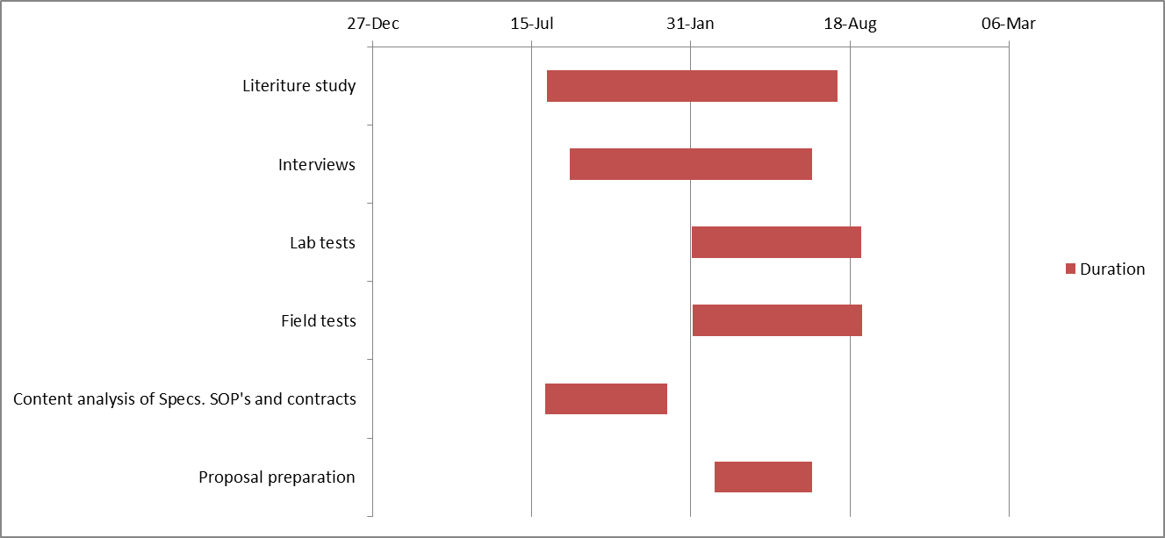
RESEARCH PLAN
Gantt chart

Slide 15


20 THANK YOU

